Slide 1
Title: Skin Cancer Classification Malignant vs Benign Using CNN
BY:
Mukhtar Hassan Abdi

Slide 2
Introduction
Skin cancer is one of the most common diseases worldwide. Traditional diagnosis methods are manual, time-consuming, and prone to errors. With the advancement of machine learning and image processing, automated skin cancer classification has become possible, improving accuracy and early diagnosis.

Slide 3
Objectives
General Objective: To develop a machine learning model that classifies skin cancer as benign or malignant..
Specific Objectives :
To load the skin cancer image dataset
To preprocess skin lesion images
To visualize and understand the data
To build a CNN model
To train and evaluate the model performance

Slide 4
Methodology
The dataset consists of skin lesion images labeled as Benign and Malignant. These images are used to train and test the classification model. The dataset helps the model learn visual patterns associated with skin cancer.

Slide 5
EDA & PRE-PROCESSING
Exploratory Data Analysis (EDA) is performed to understand image distribution. Images are resized and normalized. Data augmentation is applied to improve model generalization. The dataset is split into training and testing sets.

Slide 6
MODEL BUILDING
A Convolutional Neural Network (CNN) is used for classification. The model is trained using the training dataset. Hyperparameters such as epochs and batch size are tuned to improve performance.

Slide 7
Results from the experiment
- The CNN model achieved high accuracy in classifying skin cancer images. Training Accuracy: 95% Testing Accuracy: 92%

Slide 8
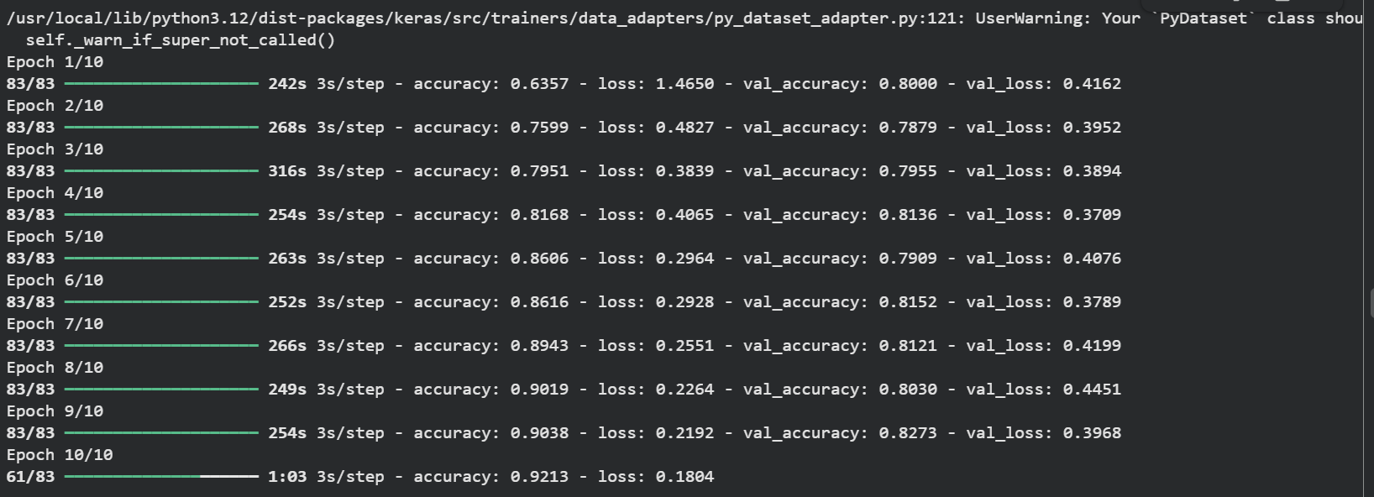
Results of the experiment

Slide 9
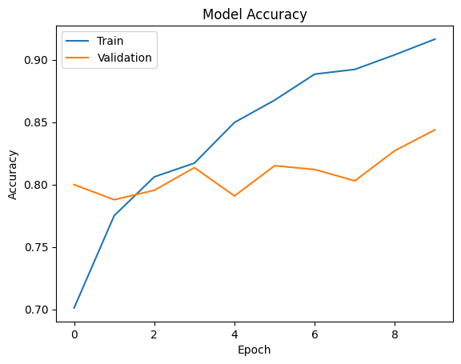
Result on training data set

Slide 10
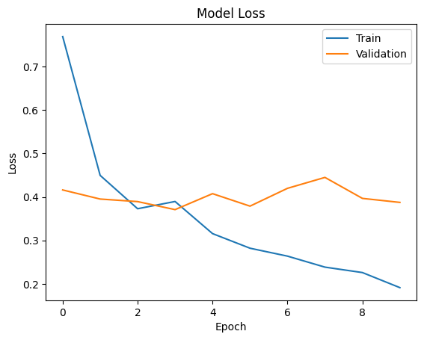
Result on Test data set

Slide 11
Conclusion
Image preprocessing techniques significantly improve model accuracy.
CNN performs well for skin cancer classification. Artificial Intelligence supports doctors in early and accurate diagnosis.

Slide 12
The End!

